Slide 1


Complaint Management System
A Full-Stack Web Application for Streamlined Feedback
PRAWIN A (23SUCA13)
REACT, SPRING BOOT
RENDER, VERCEL

Slide 2



Project Overview: Bridging Feedback Gaps
The Complaint Management System is a comprehensive full-stack web application designed to simplify and enhance the process of handling feedback. It creates a seamless channel for students to voice their concerns and for management to address them efficiently.
Effortless Complaint Submission
Transparent Management & Resolution
Robust Full-Stack Implementation
Students can easily submit detailed complaints through an intuitive user interface, ensuring their feedback is heard.
Built as a complete full-stack solution, the system ensures reliable performance and a responsive user experience from end-to-end.
Management gains a centralized platform to view, update statuses, and resolve complaints, fostering accountability and improving service quality.

Slide 3
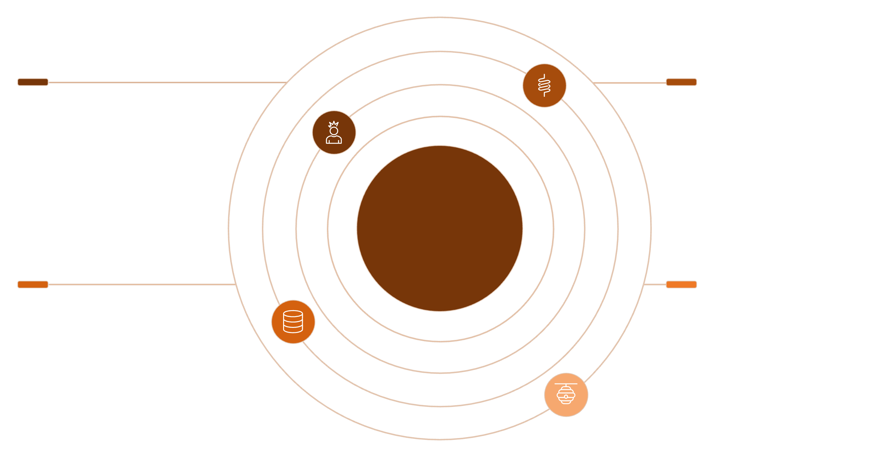
System Architecture: A Unified Approach
Our system leverages a modern and scalable architecture, meticulously separating concerns between the client-side and server-side components to ensure efficiency, maintainability, and responsiveness. Communication between these layers is handled entirely through standard RESTful APIs.
Frontend
Backend
React app deployed on Vercel
Spring Boot REST API on Render
Full-Stack Web Architecture
Database
Communication
H2 in-memory database for fast storage
REST APIs between frontend and backend
Frontend: Developed with React, hosted on Vercel for rapid deployment and global availability.
Backend: A robust Spring Boot REST API, deployed on Render's free tier, providing the core business logic.
Database: Utilizes an H2 in-memory database, ideal for development and demonstrating functionality without complex setup.
Communication: All interactions between the frontend and backend occur through well-defined RESTful APIs, ensuring modularity and interoperability.

Slide 4
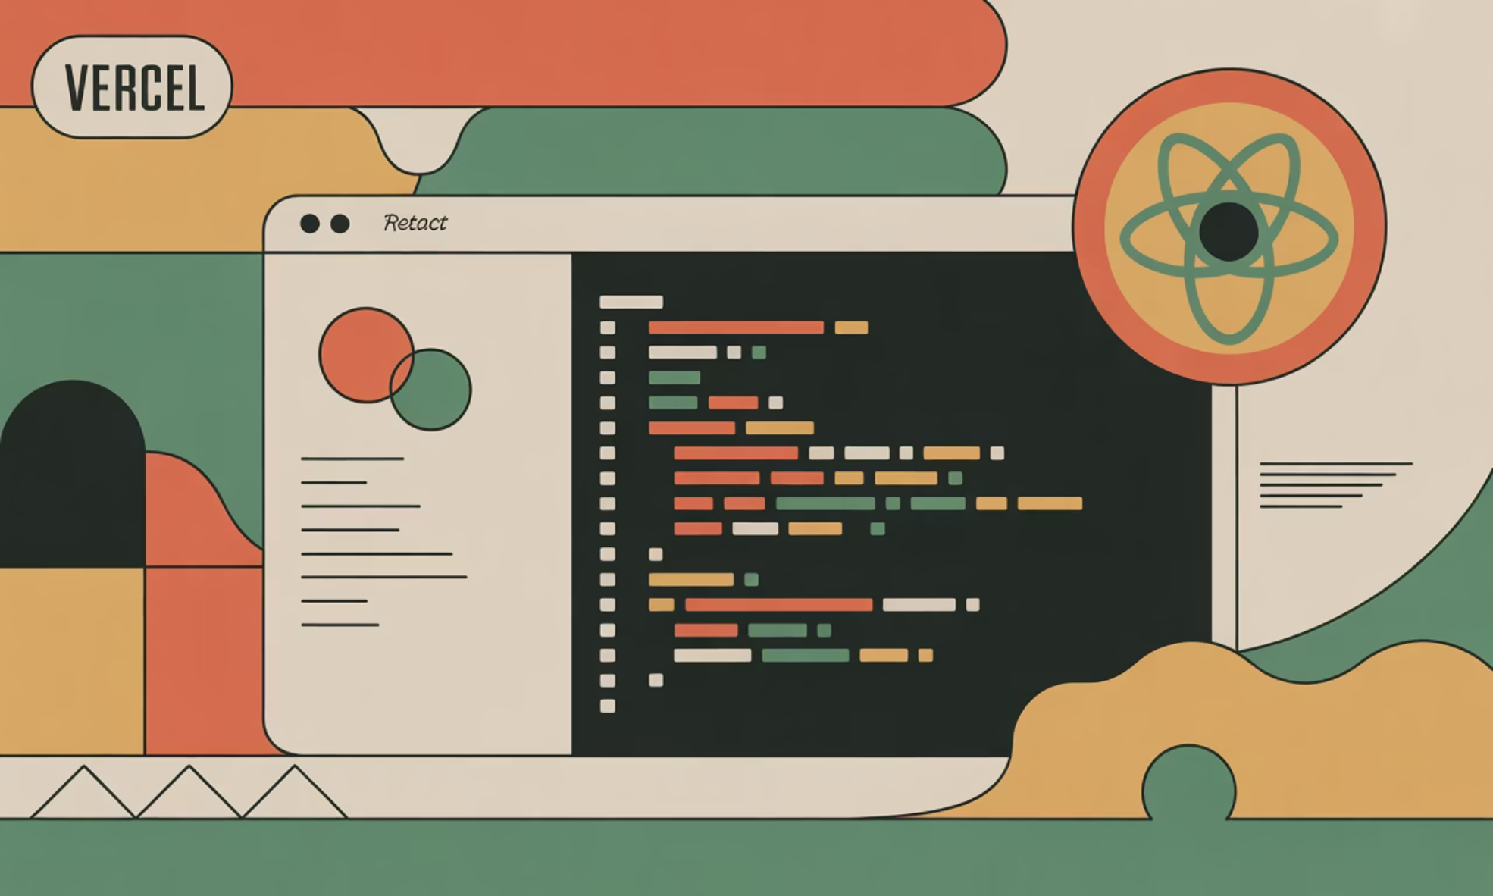
Frontend Details: The User Experience Layer
The frontend of our Complaint Management System is meticulously crafted using React, a powerful JavaScript library for building user interfaces. This choice ensures a dynamic, responsive, and intuitive experience for students submitting complaints and administrators managing them.
Core Framework: Built entirely with React to provide a component-based, scalable architecture.
API Communication: Employs Axios, a promise-based HTTP client, for seamless and efficient communication with the backend REST APIs.
Deployment: The application is deployed on Vercel, leveraging its fast global CDN and automatic CI/CD pipelines for continuous deployment.
Backend Integration: Directly connected to the backend via its Render-provided URL, ensuring smooth data flow and functionality.
Key Functionality: Manages all user-facing interactions, including complaint submission forms, real-time status displays, and user authentication flows.

Slide 5

Backend Details: The Powerhouse of Logic
The backend is the brain of our application, orchestrating data storage, business logic, and API interactions. Developed with Spring Boot, it offers a robust, enterprise-grade foundation, while Docker ensures consistent deployment across environments.
Framework: Developed using Spring Boot, providing a rapid development environment for standalone, production-grade Spring applications.
API Design: Implements a comprehensive set of RESTful APIs to expose complaint-related functionalities to the frontend, adhering to best practices for statelessness and resource-based interaction.
Containerization: The backend is Dockerized, encapsulating the application and its dependencies into a portable container for consistent deployment.
Deployment Platform: Hosted on Render (using the free plan), which provides a managed cloud environment for running containerized applications.
CORS Configuration: Carefully configured Cross-Origin Resource Sharing (CORS) policies to allow secure communication with the Vercel-hosted frontend and local development environments (localhost).

Slide 6





Automated Deployment Flow: From Code to Cloud
Our project implements a continuous deployment strategy, ensuring that code changes are automatically built, tested, and deployed to their respective environments. This streamlined process accelerates development cycles and maintains consistent application availability.
Frontend Push to GitHub
Auto Deploy to Vercel
Code changes are committed and pushed to the frontend GitHub repository.
Vercel automatically detects changes and triggers a new build and deployment of the React application.
Backend Push to GitHub
Auto Deploy to Render
Similarly, backend code changes are pushed to the backend GitHub repository.
Render automatically builds and deploys the Dockerized Spring Boot application, ensuring the latest features are always available.
Note on Render Free Plan: For cost efficiency, the backend is deployed on Render's Free Plan. This plan causes instances to spin down after periods of inactivity, requiring a brief "wake-up" period upon the first request.

Slide 7

Understanding Free Plan Behavior: A Key Consideration
Operating on a free tier deployment platform like Render comes with specific operational characteristics, particularly concerning instance availability. It's crucial to understand these behaviors to ensure a smooth user experience, especially during initial access.
Inactivity Spin-Down: To conserve resources, Render's free plan automatically puts inactive backend instances to sleep. This is a common practice for free tiers across various cloud providers.
First Access Wake-Up: The backend server must receive an initial request to "wake up" and become fully operational. This request acts as a trigger to re-initialize the application.
Startup Delay: Once triggered, the backend instance requires approximately 30-60 seconds to completely spin up and be ready to process requests. During this time, the frontend may experience initial loading delays.
Frontend Dependency: The frontend's functionality is directly dependent on the backend's availability. If the backend is spinning up, the frontend will patiently await its readiness before displaying dynamic data.
This behavior is transparent to the end-user after the initial delay, but is an important aspect of managing a free-tier deployment.

Slide 8
Code Quality & Analysis: Ensuring Excellence
Maintaining high code quality is paramount for any professional project. We integrated SonarCloud into our development workflow to continuously analyze our codebase, ensuring adherence to best practices, identifying potential bugs, and strengthening security.
SonarCloud Integration
GitHub Actions Workflow
Seamlessly integrated SonarCloud for static code analysis across both frontend (React) and backend (Spring Boot).
Automated code analysis triggers were set up using GitHub Actions, running checks on every push to the repository.
Quality Gate Passed
Zero Critical Issues
Successfully met and passed all defined Quality Gate criteria, indicating a high standard of code quality.
Verified that the codebase contains no critical bugs, vulnerabilities, or code smells, ensuring a robust and secure application.
This proactive approach to code quality significantly reduces technical debt and improves the overall reliability and maintainability of the application.

Slide 9
Tools & Technologies: Our Development Ecosystem
Our project's success is built upon a carefully selected stack of modern tools and technologies, each playing a critical role in development, deployment, and quality assurance.
React
Spring Boot
Frontend UI development
Backend API framework
Axios
Docker
HTTP client for frontend
Containerization for backend
GitHub
SonarCloud
Version control & collaboration
Code quality analysis
Render
Vercel
Backend deployment platform
Frontend deployment platform

Slide 10
Key Learnings & Future Outlook
This project was an invaluable learning experience, navigating complex challenges and successfully deploying a functional full-stack application. We've gained significant insights into modern development practices.
Challenges Faced
Conclusion & Impact
Docker Build Issues: Overcoming complexities in optimizing Dockerfiles for efficient image builds and deployment on Render.
CORS Configuration: Meticulously configuring Cross-Origin Resource Sharing to allow secure communication between independently hosted frontend and backend.
Render Free Instance Sleep Delay: Understanding and accounting for the spin-down behavior of free-tier services, implementing frontend loading states.
Git Merge Conflicts: Effectively resolving merge conflicts during collaborative development, enhancing version control proficiency.
Successfully developed and deployed a fully functional Complaint Management System, ready for practical use.
Adhered to industry-level best practices in full-stack development, from architecture to deployment.
Demonstrated proficiency in Continuous Integration/Continuous Deployment (CI/CD), Dockerization, and integrating code quality tools.
Live Application Links
Explore the live application and its source code:
Frontend: https://feedback-frontend-ochre.vercel.app/
Backend: https://feedback-backend-u96e.onrender.com
GitHub Frontend Repo: https://github.com/prawin0614/feedback_frontend
GitHub Backend Repo: https://github.com/prawin0614/feedback-backend

